Slide 1
School’s Infrastructure Analysis
Prepared by
Linxsly ALEXIS

Slide 2

Table of contents
Introduction
Exploratory & Analysis
Recommendations
Problems to solve
Visualization
Propose Solution
Goal of the project
Machine Learning
Presentation
Public cible
Thank you
Data Source
Methodology

Slide 3

Story Telling
You live with a family? You have children? Brothers? Sisters?
You have to move on with your family from a department to another one? What about your children’s career? Which school would you choose for them?
So many unanswered questions... Perhaps due to a lack of information about the infrastructure of the schools or a lack of knowledge about their performance...
What will you prioritize? Infrastructure or results? Or maybe both?
3

Slide 4

Problems to be solved
We would like to rank the schools according to their vulnerability in relation to their infrastructure and their level of performance.
4

Slide 5
Process
1- Create a score
2- Do a clustering
3- Create a dashboard

Slide 6

Target Audience
1- Families who migrate from a department to another one.
2- The government(MENFP)

Slide 7



Data Source
The data we used comes from the MENFP database, via Ayiti Analytics. And they include the number of schools per municipality, infrastructure, student results, school information.
7

Slide 8



Methodology
Cleaning data
it’s the most hard part , we remove and replace null values and the wrong values.
Collect data
We receive data from DHS P rogram
We complete the dataset with the data from Ayiti Analytics data
We use Open Street Map API to ﬁnd geolocate
Analysis
We analyze the data
We perform a Machine Learning (K_means Clustering)

Slide 9
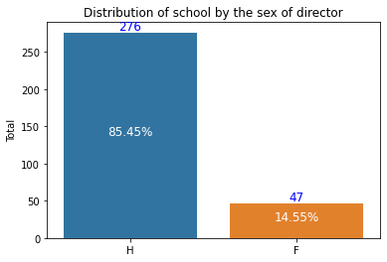
As we can see only 14% of the directors of the dataset are women, compared with 82% of men. The 3% left is undefined. Maybe it's a problem with the survey or the investigators. Or these schools don't have an organizational structure.

Slide 10
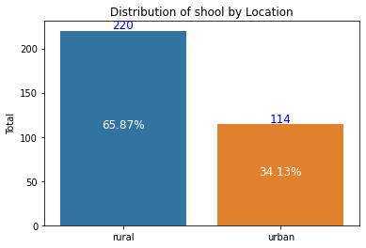
As we can see, more than 65% of the schools are located in rural zones. The other 34% are in urban zones. Can we say that there are more rural zones than urban in those 3 departments?.

Slide 11
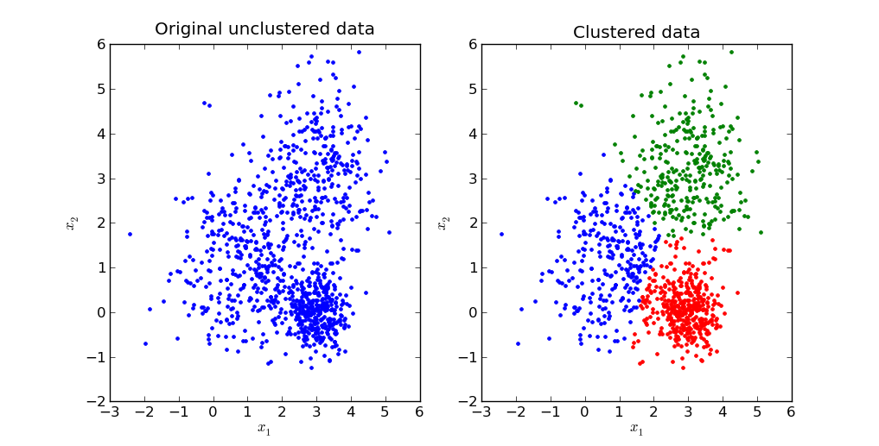
KMeans Clustering
We will perform a k-mean clustering which consists in grouping the data in several groups of commune in our case according to the similarities of their schools’ infrastructure or results after having determined the optimal number of group or cluster = k. In our case k=3.

Slide 12
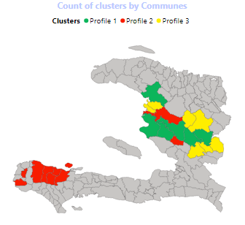
This map shows the distribution of the clusters by commune for the three departments that I had to work on. (Centre, Artibonite, Grande’Anse)

Slide 13
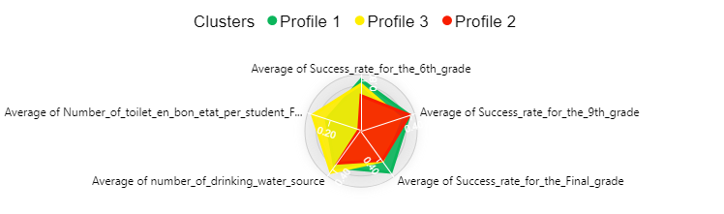
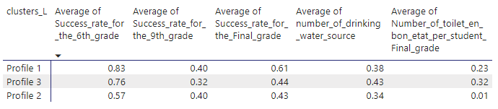
Description of the clusters
This is a description of the three clusters, we can notice that there’s a small difference of the success rate in the three clusters, and for the infrastructure too… We can notice the profile the most vulnerable is the second one. They have less infrastructures than any others.

Slide 14
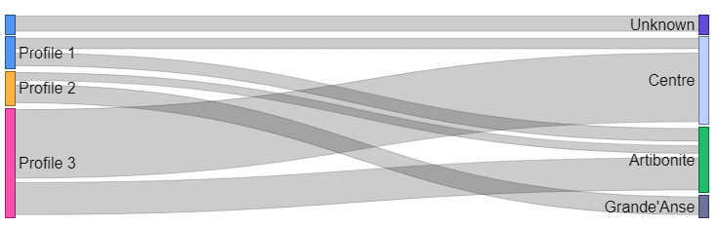
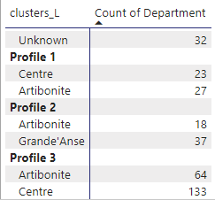
This graph shows the number of clusters by department. The second profile, which is the worst, is the only one profile to have school in Grande’Anse. That means, in this department, there are not only an infrastructure’s problem but also an educational problem.

Slide 15

Recommendations
We’ve made a dependence test between the infrastructure and the success rate. We’ve found that they are not dependent. Correlation is not causation, we already know that the success rate is correlated with the infrastructure of the schools based on some studies conducted by international organizations such as World Bank... Because of this we will suggest the government to give more grant programs in this municipalities.

Slide 16
Recommendations
According to the data and analysis, we will suggest the family to use our dashboard, more precisely the radar chart to see clearly the municipalities with the best performance and the best infrastructures. If they need to introduce some others factors

Slide 17




Contact
Linxsly ALEXIS
+509 46976429
alexislinxsly@gmail.com

Slide 18
Thank You
For The Attention

Slide 19
QUESTIONS?

